Slide 1
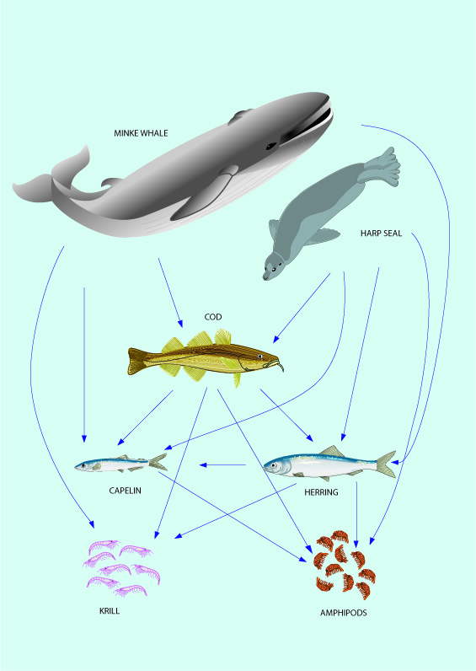

Overall conclusion from the Fmsy-project and what it could mean for fisheries management
Henrik Sparholt
NMTT Dr.Sc.

Slide 2
We propose a new set of Fmsy values for data rich stocks in the North Atlantic

Slide 3
They are:
- with no bias known to science
- using the available science on ecosystem functioning

Slide 4
Final set
Stock | Current Fmsy | Final new Fmsy values
Blue whiting | 0.32 | 0.32
Cod Icelandic |  | 0.56
Cod in divisions 7.e–k (western English Channel and southern Celtic Seas) | 0.35 | 0.63
Cod North Sea | 0.33 | 0.77
Cod Northeast Arctic | 0.40 | 0.56
Cod Faroe Plateau | 0.32 | 0.41
Cod Western Baltic Sea | 0.26 | 0.62
Haddock Icelandic |  | 0.45
Haddock Faroe | 0.25 | 0.29
Haddock Rockall | 0.20 | 0.31
Haddock Irish Sea | 0.27 | 0.41
Haddock VIIb-k | 0.40 | 0.87
Haddock North Sea | 0.19 | 0.58
Haddock Northeast Arctic | 0.35 | 0.39
Hake Northern | 0.28 | 0.61
Hake Southern | 0.25 | 0.55
Herring Western Baltic | 0.32 | 0.31
Herring Icelandic | 0.22 | 0.26
Herring Irish Sea | 0.26 | 0.43
Herring Celtic Sea and South of Ireland | 0.26 | 0.41
Herring North Sea | 0.33 | 0.46
Herring Gulf of Riga | 0.32 | 0.42
Herring 25–29, 32 xGoR | 0.22 | 0.28
Mackerel | 0.22 | 0.37
Plaice E Channel | 0.25 | 0.26
Plaice Kattegat Sund | 0.37 | 0.55
Plaice North Sea | 0.19 | 0.42
Saithe Icelandic |  | 0.30
Saithe Faroe | 0.30 | 0.36
Saithe North Sea etc. | 0.36 | 0.44
Saithe Northeast Arctic |  | 0.40
Sole Irish Sea | 0.20 | 0.22
Sole Eastern Channel | 0.30 | 0.61
Sole Western Channel | 0.29 | 0.23
Sole Bristol Chanel Celtic Sea | 0.27 | 0.39
Sole Kattegat | 0.23 | 0.32
Sole Bay of Biscay | 0.33 | 0.40
Sole North Sea | 0.20 | 0.40
Sprat Baltic Sea | 0.26 | 0.40

Slide 5
Preliminary results for 14 more stocks
Stock |  | ICES 2016 | Froese et al. SPM | Multispecies | Inferred from other stocks | Final preliminary
 |  | a | b | c | d | e
Cod W Scotland | 1 | 0.17 |  |  | 0.69 | 0.69
Cod Irish Sea | 2 | 0.37 | 0.95 |  |  | 0.95
Cod Eastern Baltic Sea (pre 2012) | 3 | - | - | 0.87 |  | 0.87
Herring W Scotland and W Ireland | 4 | 0.16 | 0.22 |  | 0.39 | 0.30
Herring Norwegian SSP | 5 | 0.15 | - |  | 0.26 | 0.26
Herring Bothnian Sea | 6 | 0.15 | - |  | 0.34 | 0.34
Horse mackerel W | 7 | 0.13 | - |  | 0.37 | 0.37
 |  |  | Surplus Production Models |  |  | Final
 |  |  | Schaefer | Thorson tax | Thorson pooled
 |  |  | Model 5 | Model 7 | Model 8
Blue ling Vb-VI-VII | 8 | 0.12 | 0.18 | 0.18 | 0.19 | 0.18
Tusk Va and XIV | 9 | 0.226 | 0.15 | 0.15 | 0.14 | 0.15
Golden Redfish V-VI-XII-XIV | 10 | 0.097 | 0.11 | 0.13 | 0.11 | 0.12
Megrim (L. whif.) in divisions 7.b–k, 8.a–b, and 8.d | 11 | 0.19 | 0.53 | 0.59 | 0.55 | 0.55
Ling Iceland Grounds | 12 | 0.284 | 0.43 | 0.44 | 0.38 | 0.42
Atlantic menhaden | 13 | - | 0.76 | 0.74 | 0.75 | 0.75
Summer flounder Mid-Atlantic Coast | 14 | - | 1.08 | 1.12 | 1.10 | 1.10
Footnotes.
1d. Mean of cod in Irish Sea, in divisions 7.e–k (western English Channel and southern Celtic Seas), the North Sea, and Faroe Islands (0.95, 0.63, 0.77, 0.41) equal to 0.69.
3c. Most complete model: Multispecies FMSY Gislason (1999). The options assuming constant relationship in F between the three stocks (that of 1996).
4d. Mean of Herring Icelandic, Herring Irish Sea, Herring Celtic Sea and South of Ireland, Herring North Sea, (i.e. 0.26, 0.43, 0.41, and 0.46) equal to 0.39.
4e. Mean of the two values
.
6d. Similar to Icelandic herring.
7d. Average of herring in western Baltic (0.31), herring in Guld of Riga (0.42) and herring 25–29, 32 xGoR (0.28).
8d. Assumed equal to mackerel due to similar growth and maximum age.
Don’t read all the text now – maybe do it afterwards

Slide 6
If you choose to use the new Fmsy values – it is very easily done....

Slide 7
”Business as usual” except with new Fmsy values
-- still use the ICES HCR – so the risk to stock collapse very small !!
Present Fmsy
New Fmsy

Slide 8
It is urgent – if not some catch is foregone.
The project has bridged the ”gap between science (...on ecosystem functioning...) available and fisheries advice/management”.

Slide 9
We suggest, managers still do not need to consider the balance between species for using the proposed set of F_{MSY} values.
The Fmsy-project does not suggest a full multispecies approach, …but much closer to it than the current approach
We add mainly density dependent growth, maturity and (if relevant) cannibalism, to the current single species way of estimating F_{MSY}
The lack of full multispecies approach means that the new FMSY values should only be regarded as valid for say 5 years, before being renewed. Stock sizes can for this short time period be considered reasonable constant and thus species-interactions parameters as well

Slide 10
Overall argument for using the new Fmsy set
This new set of Fmsy is not perfect, but without biases know to science;
We should aim for the perfect. We will never get there, but gradually move closer – it is a ”journey”;
On the ”journey” use the ”best available” science at any point in time;
The new set of Fmsy is using present day robust science on ecosystem functioning, which has passed the ”test of time” of decades.

Slide 11

The new Fmsy values might be more variable ...but it is better to be vaguely right than precisely wrong!

Slide 12
Which Management Plan to use?
Several stocks have special Management Plans, tested by science, and agreed by managers.
For Icelandic cod, Barents Sea cod and Barents Sea haddock these have been tested including density dependence and are therefore in line with our new Fmsy values
For other stocks – new tests are in principle needed that include DD.

Slide 13
1. Conduct these tests by including DD in growth, etc. or do them with Surplus Production Models
2. Use ICES default HCR in management until these tests are done.
...or...
3. Continue using the current plans. They are still precautionary with the new Fmsy, ...but some yield will be foregone
Which Management Plan to use together with the new Fmsy?

Slide 14
Alternative solution 1 (...to replace the current Fmsy values with the new ones)
Middle MSY Btrigger could be 1.25 or 1.5 Bpa
Upper MSY Btrigger could be 1.50 or 2.0 Bpa

Slide 15
Alternative solution 2
Catch each year the amount that reduces SSB to Bpa (so-called ”escapement strategy”, used already for short lived species)
...gives only a few % lower yield than MSY – and it furthermore benefits other species because it decreases predation and food composition

Slide 16
Alternative solution 3
Implement the new Fmsy values, but only for stocks above Bpa /MSY Btrigger.
This approach will mean that stocks below will recover with the same speed as at current Fmsy values (linearly decreased according to the HCR).

Slide 17
Alternative solution 4
Implement the new Fmsy values, but gradually over say 3 years.
...this is up to managers and stakeholders – not science - to decide...

Slide 18
But remember....
Each year of delay or partly delay will cost in foregone catch – a price to pay for a delay which managers might not like

Slide 19
All material are available on https://www.fmsyproject.net/
Will be published in peer reviewed journals within the next year

Slide 20
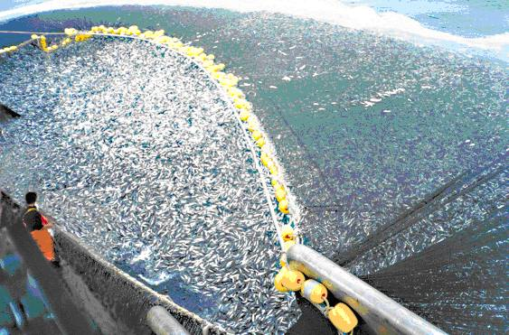
Thank a lot for coming !

