Slide 1
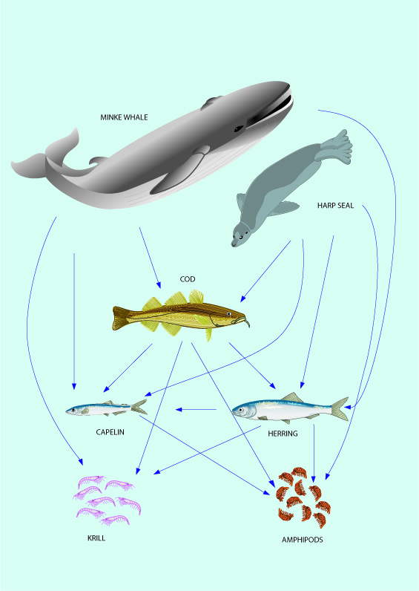

Optimizing sustainable fishing yields - ecosystem and management perspectives
Setting the scene
Henrik Sparholt,
NMTT, Dr.Sc

Slide 2
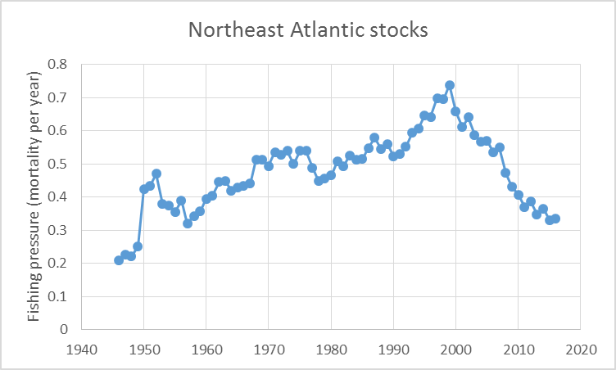
Background
Recent success of fisheries management
Fishing pressure reduced → stocks are building up → increased importance of stock interactions and ecosystem functioning such as density dependence
ICES Stabdard Graph Database 2018

Slide 3
Northeast Atlantic
Overfishing has ended
The major fish stocks in the Northeast Atlantic waters are rebuilding
Exploitation pressure currently aimed at: 1/3 of what it was just 5-8 years ago
The multispecies and ecosystem science tells us that this will be an under-exploitation
The indications are that:
  F should only be reduced to 1/2 of the past level
  Aiming for 1/2 in management will result in about 40% higher sustainable catch in the Northeast Atlantic (ICES area) corresponding to around 4 million tonnes per year worth 5 billion €*
*https://ec.europa.eu/eurostat/statistics-explained/index.php?title=File:Landings,_2008_and_2016.png

Slide 4
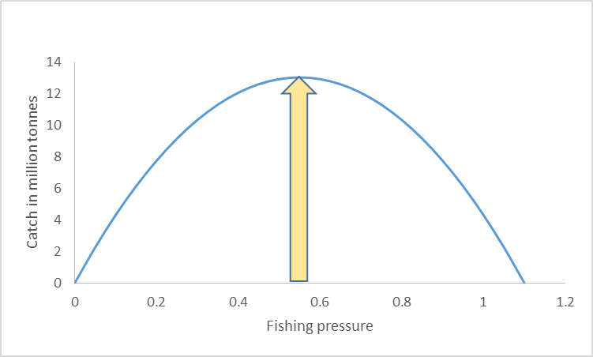
All fish stocks in the Northeast Atlantic – the true ecosystem Fmsy (yellow)
Towards Ecosystem Fmsy
Overfishing 1980s, 1990s and 2000s
Current single species Fmsy

Slide 5
Oceana (Froese et al. 2016).
”Total catches across all stocks and regions were 8.8 million tonnes …..potential increases in catch of over 50% would be possible …”
- ICES area catch constitute about 93% of the MSY calculated by Oceana (Black Sea and the Mediterranean 7%).

Slide 6
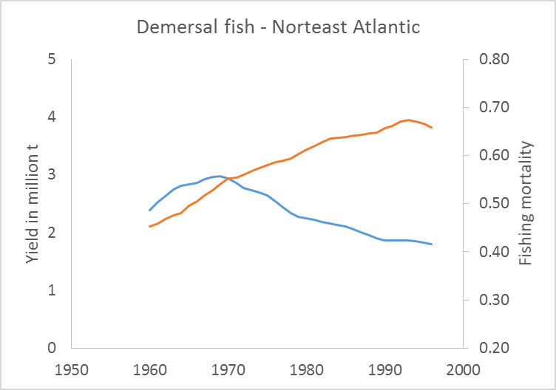
The big ”Experiment”
Red line: F
Blue line: Catch
Fmsy ~0.55
You will later see that our new Fmsy values are consistent with this value with an average of 0.50.
Sparholt and Cook 2009

Slide 7
Urgent need for correction of management
Some stocks already rebuil:
  North Sea plaice, Northern hake, Northeast Arctic cod, Baltic sprat ...
Urgent need for correction – else foregone catch of about 4 million t – each year.
We are a dozen scientists with the needed expertise on ecosystem functioning, ... sat up the Fmsy project

Slide 8
”Fmsy project” - 2017-2018
Funding agencies:
  Nordic Council of Ministers
  EU-EMMF and Danish Ministry of Fisheries
  Norwegian Fisheries Research Fund
https://www.fmsyproject.net/

Slide 9
Objective
Come up with new Fmsy values based on ecosystem functioning:
  -- for data rich stocks in North Atlantic

Slide 10
...by way of
  ”Bridging the gap” between science and scientific advice/management
  Bring multispecies and ecosystem science into Fmsy calculations

Slide 11
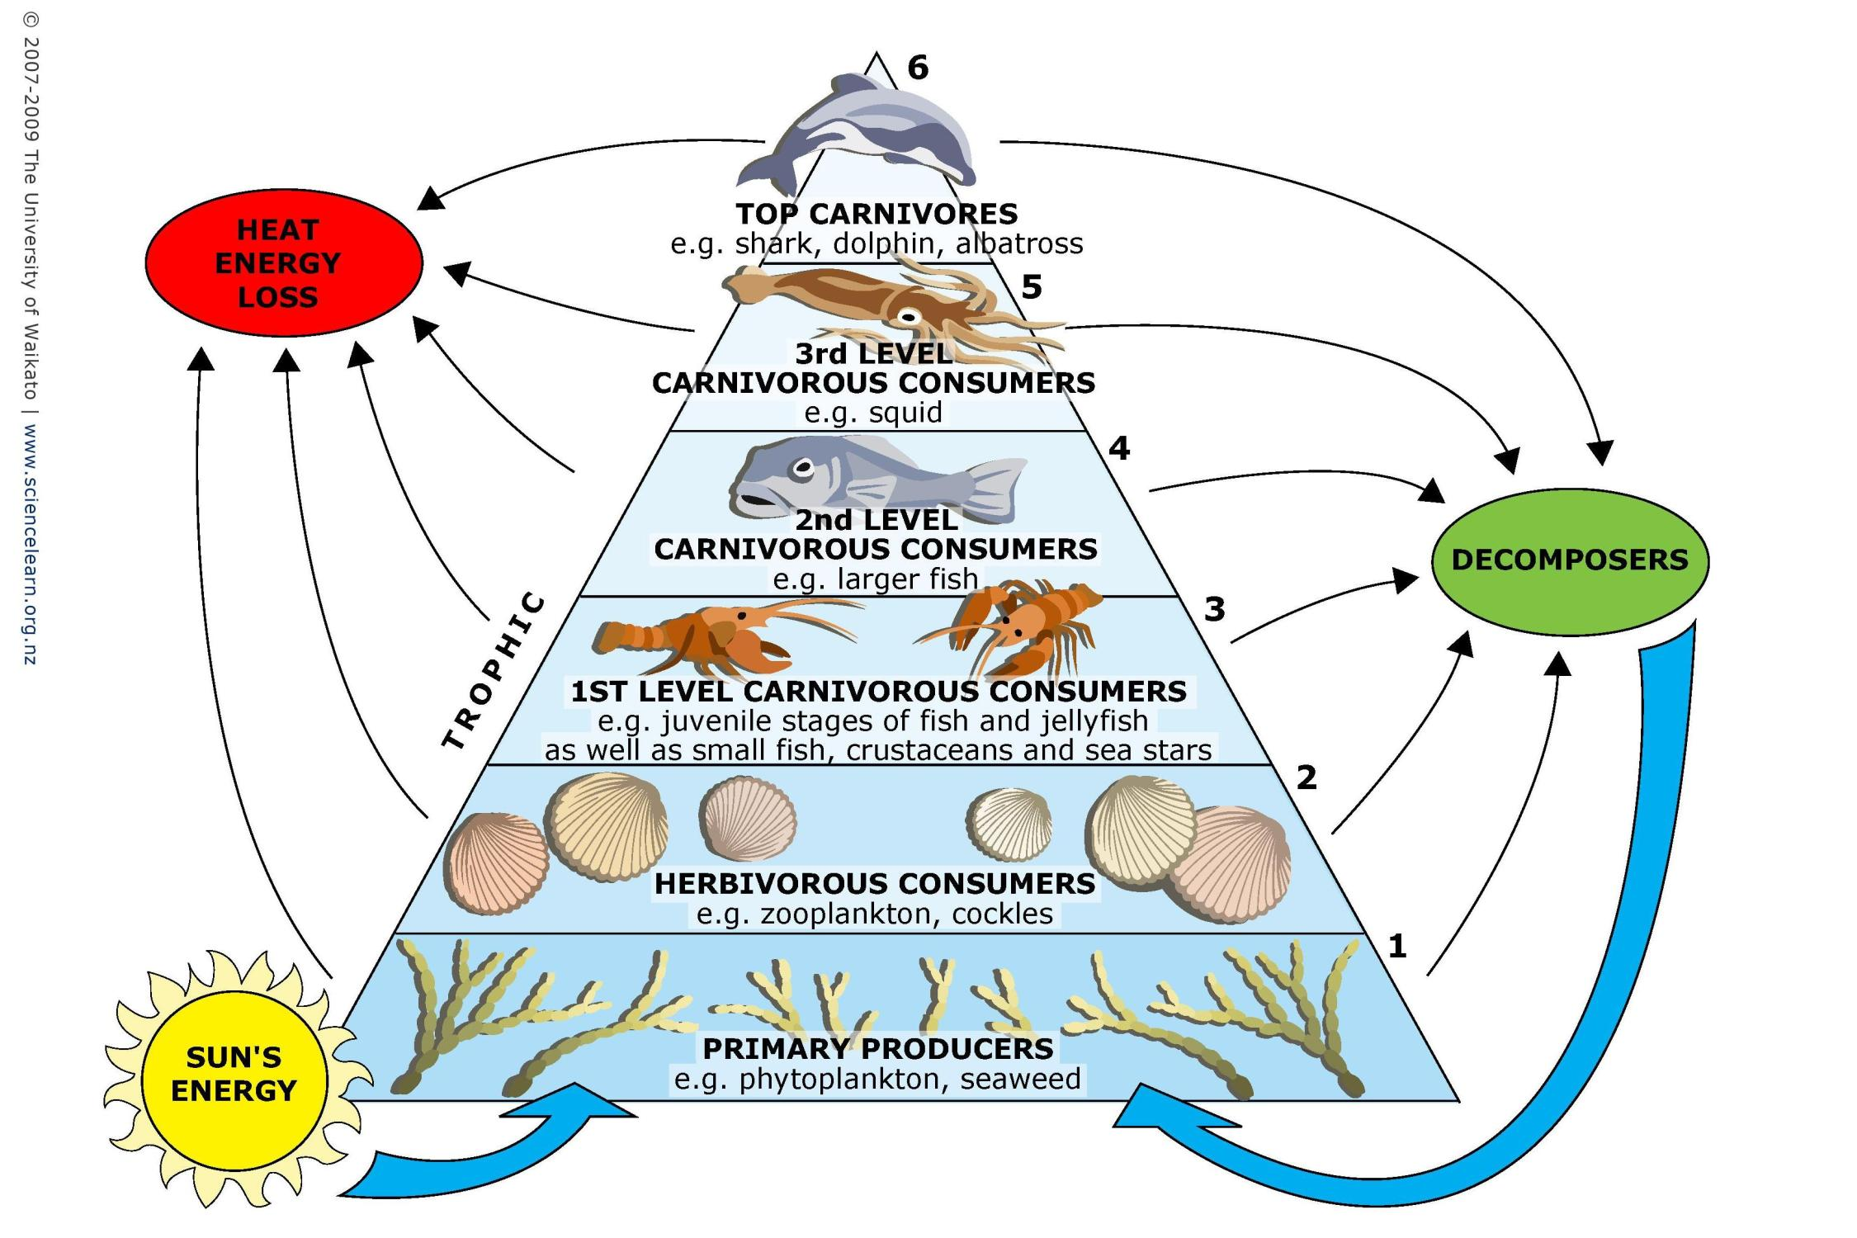
Ecosystem productivity
Notes:
Basic ecosystem concepts
The production in an ecosystem is based on primary production.
This production is moving up the food web and at each tropic level there is only a certain amount of production possible.
If the fishing is too light the fish stocks will be too large and burn too much production for metabolic maintenance (convert to C0₂) - production which could otherwise have been harvested.
If the fishing is too hard the fish stocks will be too small and not produce enough juveniles.

Slide 12
Basic ecosystem concepts
The production in an ecosystem is based on primary production.
This production is moving up the food web.
If fishing is too light: → the fish stocks will be too large → burn too much production in metabolic maintenance (convert production to C0₂) - production which could otherwise have been harvested as fish meat.
If the fishing is too hard: → the fish stocks will be too small and not produce enough juveniles.

Slide 13
Baranov 1918, Graham 1947, Beverton&Holt 1957, Ricker 1958, Hilborn&Walters 1992, Longhurst 2010, and many others…
Longhurst, A. 2010. Mismanagement of marine fisheries. Cambridge University Press, Cambridge, UK:
” For any level of fishery harvest to be sustainable, some or all of the biological processes contributing to production must be compensatory, i.e. increasing as stock biomass decreases…”

Slide 14
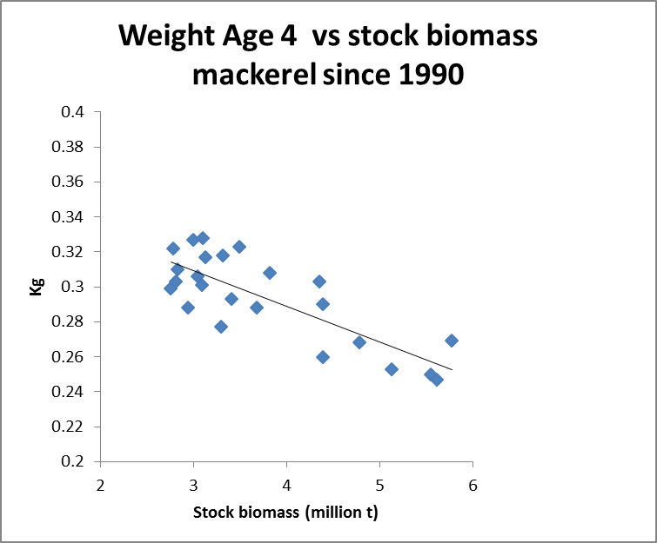
Example – growth – so-called ”density dependence”

Slide 15
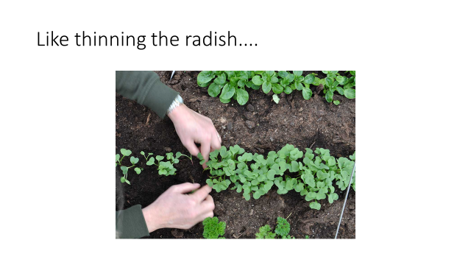
Density dependence is...

Slide 16
Four compensatory mechanisms –
Taken into account in current management?
Density dependent recruitment
Density dependent individual fish growth
Density dependent mortality
Density dependent maturity
√
Not yet
Not yet
Not yet
Missing any of these in Fmsy calculations will give a downward bias!
Notes:
The way ecosystem functions in relation to fish is via Four compensatory mechanisms are important for fisheries management and fish stock dynamics:
DD r means that the number of juveniles produced each year is not increased infinitely when the stock size increase, at some stage a further increase in stock does give more juveniles – or put the other way around when a fishery starts on a pristine stock, the stocks decreases but the they still produce almost the same amount of juvenlies. So it compensates by producing more juveniles by female.
DD growth of individual fish also increases when the stock decreases – the improved growth in that way compensate to some extent for the reduced stock numbers
Same with mortality – the mortality decreasse as the stock decrease and thus more will survive and thus compensate for the reduction. Especially when we have to do with speces that are cannibals as cod are this can be quite important.
DD maturity fish mature at a younger age when the stock is small –

Slide 17
...and of course, scientific advice should be unbiased
ICES Strategic Plan 2014–2018:
” …commitment to maintain ICES as a strong and independent scientific organization in order to improve its capacity to give unbiased, sound, reliable, and credible scientific advice on human activities affecting, and affected by, marine ecosystems;”

Slide 18
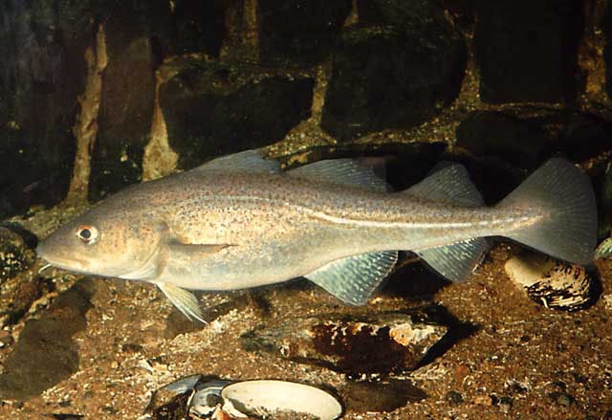
Example:
  Yield/SSB
  vs
  Fishing pressure
North Sea cod

Slide 19
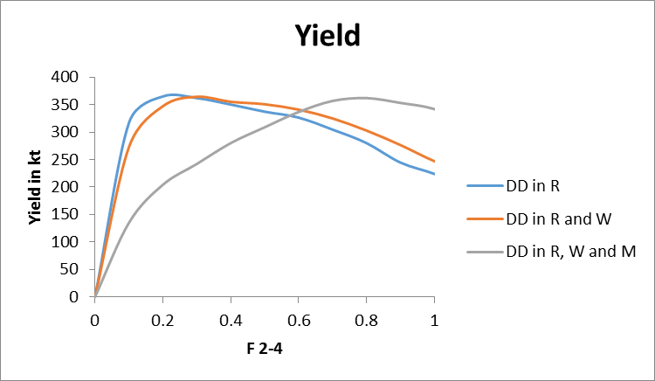
Example:
  Yield
  vs
  Fishing pressure
North Sea cod

Slide 20
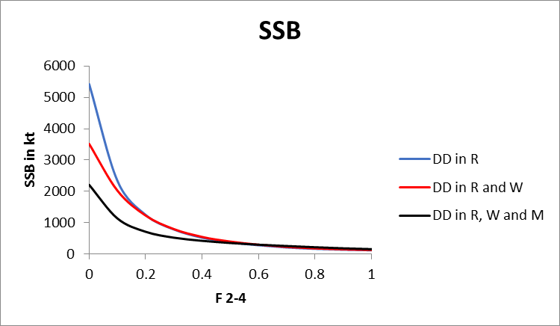
Example:
  SSB
  vs
  Fishing pressure
North Sea cod

Slide 21
Three basic ideas in the Fmsy-project
Multi-variate statistical approach to ”spread” the available ecosystem Fmsy values to all stocks
Use of Surplus Production Models - that implicitly includes all 4 density dependent elements - on the existing stock assessment time series of catch, F and SSB
Direct calculations based on established DD effects for a handfull of stocks

Slide 22
The Surplus Production Models approach
These models are very well established in fisheries science – used globally in routine assessments for hundreds of stocks
We used assessment time series of annual catch and SSB (from e.g. ICES ”Summary table”) as data.
...discoved later that two other research groups (one by Oceana in Germany and one at Ram Myers Lagacy Database in Seattle) were doing the same thing – but only the Fmsy project made the last link to current assessments

Slide 23
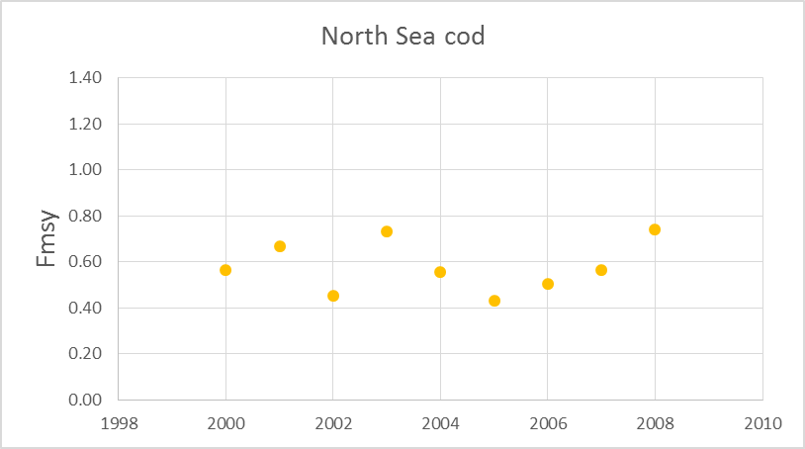
Fmsy /F (from SPM)
...multiplied by
F (from ICES)
=
Fmsy (in ICES F -”currency”)
F/Fmsy
SPM
1963 1975 1990 2015
F age 2-4
ICES assessment
1963 1975 1990 2015

Slide 24
Magnuson-Stevens Fisheries Conservation and Management Act (FCMA) (…and FAO, EU, …)
“…managers are required to use the best scientific information available…”.
And ICES:
“ICES advice … is based on the best available science and data…”
http://www.ices.dk/community/advisory-process/Pages/Basis-for-ICES-Advice.aspx

Slide 25
Available science in ecosystem functioning
  four decades of intensive research
  hundreds of peer reviewed papers
  more than 1.5 million fish stomachs analyzed
  hundreds of person-years spend on fish evacuation experiments
  a multitude of models developed

Slide 26
Let us pick the low hanging fruits now.
The need is urgent!

Slide 27
We still work on single species – so managers will – like today - not be asked to make priorities between stocks

Slide 28
We suggest, managers still do not need to consider the balance between species for using the proposed set of F_{MSY} values.
The Fmsy-project does not aim for a full multispecies approach, …but much closer to it than the current approach
The focus will be on adding mainly density dependent growth, maturity and (if relevant) cannibalism, to the current single species way of estimating F_{MSY}
The lack of full multispecies approach means that the new FMSY values should only be regarded as valid for say 5 years, before being renewed. Stock sizes can for this short time period be considered reasonable constant and thus species-interactions parameters as well

Slide 29
 | Oceana (Froese et al 2016) |  |  | RAM database
 |  |  |  | Schaefer | Thorson tax | Thorson pooled
Blue whiting | 0.37 |  |  | 0.27 | 0.27 | 0.25
Cod Icelandic | 0.63 |  |  | 0.50 | 0.49 | 0.50
Cod in divisions 7.e–k (western English Channel and southern Celtic Seas) | 0.56
Cod North Sea | 0.70 |  |  | 0.78 | 0.78 | 0.74
Cod Northeast Arctic | 0.55 |  |  | 0.48 | 0.49 | 0.48
Cod Faroe Plateau | 0.36 |  |  | 0.46 | 0.46 | 0.45
Cod Western Baltic Sea | 0.62
Haddock Icelandic | 0.47 |  |  | 0.43 | 0.43 | 0.43
Haddock Faroe | 0.28 |  |  | 0.30 | 0.30 | 0.30
Haddock Rockall | 0.31
Haddock Irish Sea | 0.41
Haddock VIIb-k | 0.87 |  |  | 0.86 | 0.86 | 0.88
Haddock North Sea |  |  |  | 0.56 | 0.56 | 0.61
Haddock Northeast Arctic | 0.43 |  |  | 0.36 | 0.36 | 0.35
Hake Northern | 0.82 |  |  | 0.41 | 0.41 | 0.38
Hake Southern | 0.59 |  |  | 0.51 | 0.51 | 0.50
Herring Western Baltic | 0.33 |  |  | 0.31 | 0.26 | 0.29
Herring Icelandic | 0.23 |  |  | 0.29 | 0.31 | 0.30
Herring N. Irish Sea | 0.43
Herring Celtic Sea and South of Ireland | 0.34 |  |  | 0.45 | 0.50 | 0.47
Herring North Sea | 0.58 |  |  | 0.26 | 0.28 | 0.27
Herring Gulf of Riga | 0.34 |  |  | 0.51 | 0.49 | 0.50
Herring 25–29, 32 xGoR | 0.21
Mackerel | 0.36 |  |  | 0.32 | 0.34 | 0.32
Plaice E Channel | 0.27 |  |  | 0.27 | 0.23 | 0.25
Plaice Kattegat Sund | 0.55
Plaice North Sea | 0.47 |  |  | 0.38 | 0.36 | 0.37
Saithe Icelandic | 0.31 |  |  | 0.30 | 0.30 | 0.29
Saithe Faroe | 0.37 |  |  | 0.36 | 0.36 | 0.35
Saithe North Sea etc. | 0.54
Saithe Northeast Arctic | 0.49 |  |  | 0.32 | 0.32 | 0.31
Sole Irish Sea | 0.18 |  |  | 0.27 | 0.23 | 0.26
Sole Eastern Channel | 0.48 |  |  | 0.69 | 0.80 | 0.73
Sole Western Channel | 0.26 |  |  | 0.21 | 0.18 | 0.20
Sole Bristol Chanel Celtic Sea | 0.31 |  |  | 0.44 | 0.51 | 0.47
Sole Kattegat | 0.38 |  |  | 0.28 | 0.26 | 0.27
Sole Bay of Biscay | 0.43 |  |  | 0.38 | 0.34 | 0.37
Sole North Sea | 0.38 |  |  | 0.41 | 0.45 | 0.42
Sprat Baltic Sea | 0.42 |  |  | 0.29 | 0.30 | 0.29
Several new sets of Fmsy values
-from various settings of
Surplus Production Models

Slide 30
 |  | Multi-species |  | PROST-type
Blue whiting
Cod Icelandic |  |  |  | 0.70
Cod in divisions 7.e–k (western English Channel and southern Celtic Seas)
Cod North Sea |  | 0.87 |  | 0.70
Cod Northeast Arctic |  |  |  | 0.60
Cod Faroe Plateau
Cod Western Baltic Sea
Haddock Icelandic
Haddock Faroe
Haddock Rockall
Haddock Irish Sea
Haddock VIIb-k
Haddock North Sea |  | 0.58
Haddock Northeast Arctic
Hake Northern
Hake Southern
Herring Western Baltic
Herring Icelandic
Herring N. Irish Sea
Herring Celtic Sea and South of Ireland
Herring North Sea |  | 0.50
Herring Gulf of Riga
Herring 25–29, 32 xGoR |  | 0.35
Mackerel |  |  |  | 0.40
Plaice E Channel
Plaice Kattegat Sund
Plaice North Sea
Saithe Icelandic
Saithe Faroe
Saithe North Sea etc. |  | 0.33
Saithe Northeast Arctic
Sole Irish Sea
Sole Eastern Channel
Sole Western Channel
Sole Bristol Chanel Celtic Sea
Sole Kattegat
Sole Bay of Biscay
Sole North Sea
Sprat Baltic Sea |  |  |  | 0.45
A few more Fmsy values from:
-Ecosystem models and direct calculations including density dependence

Slide 31
Final set
Mean new Fmsy = 0.43
Mean ICES Fmsy = 0.28
Stock | ICES | Final new Fmsy values
Blue whiting | 0.32 | 0.32
Cod Icelandic |  | 0.56
Cod in divisions 7.e–k (western English Channel and southern Celtic Seas) | 0.35 | 0.63
Cod North Sea | 0.33 | 0.77
Cod Northeast Arctic | 0.40 | 0.56
Cod Faroe Plateau | 0.32 | 0.41
Cod Western Baltic Sea | 0.26 | 0.62
Haddock Icelandic |  | 0.45
Haddock Faroe | 0.25 | 0.29
Haddock Rockall | 0.20 | 0.31
Haddock Irish Sea | 0.27 | 0.41
Haddock VIIb-k | 0.40 | 0.87
Haddock North Sea | 0.19 | 0.58
Haddock Northeast Arctic | 0.35 | 0.39
Hake Northern | 0.28 | 0.61
Hake Southern | 0.25 | 0.55
Herring Western Baltic | 0.32 | 0.31
Herring Icelandic | 0.22 | 0.26
Herring Irish Sea | 0.26 | 0.43
Herring Celtic Sea and South of Ireland | 0.26 | 0.41
Herring North Sea | 0.33 | 0.46
Herring Gulf of Riga | 0.32 | 0.42
Herring 25–29, 32 xGoR | 0.22 | 0.28
Mackerel | 0.22 | 0.37
Plaice E Channel | 0.25 | 0.26
Plaice Kattegat Sund | 0.37 | 0.55
Plaice North Sea | 0.19 | 0.42
Saithe Icelandic |  | 0.30
Saithe Faroe | 0.30 | 0.36
Saithe North Sea etc. | 0.36 | 0.44
Saithe Northeast Arctic |  | 0.40
Sole Irish Sea | 0.20 | 0.22
Sole Eastern Channel | 0.30 | 0.61
Sole Western Channel | 0.29 | 0.23
Sole Bristol Chanel Celtic Sea | 0.27 | 0.39
Sole Kattegat | 0.23 | 0.32
Sole Bay of Biscay | 0.33 | 0.40
Sole North Sea | 0.20 | 0.40
Sprat Baltic Sea | 0.26 | 0.40

Slide 32
No forage fish stocks included
These are too influenced by the changed biomass of the data rich stocks over time. However, by adopting the new Fmsy values the stock biomass of the data rich stocks will be smaller → more forage fish will survive → improved fishing prospects ....a positive side effect.

Slide 33
Urgent actions needed – about 4 million t of catch is foregone each year!
Towards Ecosystem Fmsy
Current single species

Slide 34
We see a problem with the current Fmsy values – they are biased downwards and not using the available ecosystem science.
There are probably several ways to rectify it
...but it is pretty urgent
We intend to propose this set of Fmsy values - that has no bias known to science and are using the available ecosystem science
... it is very easily done...

Slide 35
”Business as usual” except with new Fmsy values
-- still use the ICES HCR – so the risk to stock collapse very small !!
Present Fmsy
New Fmsy

Slide 36
Our new Fmsy estimates might be a less precise than the current ones – we are not sure of that but...

Slide 37
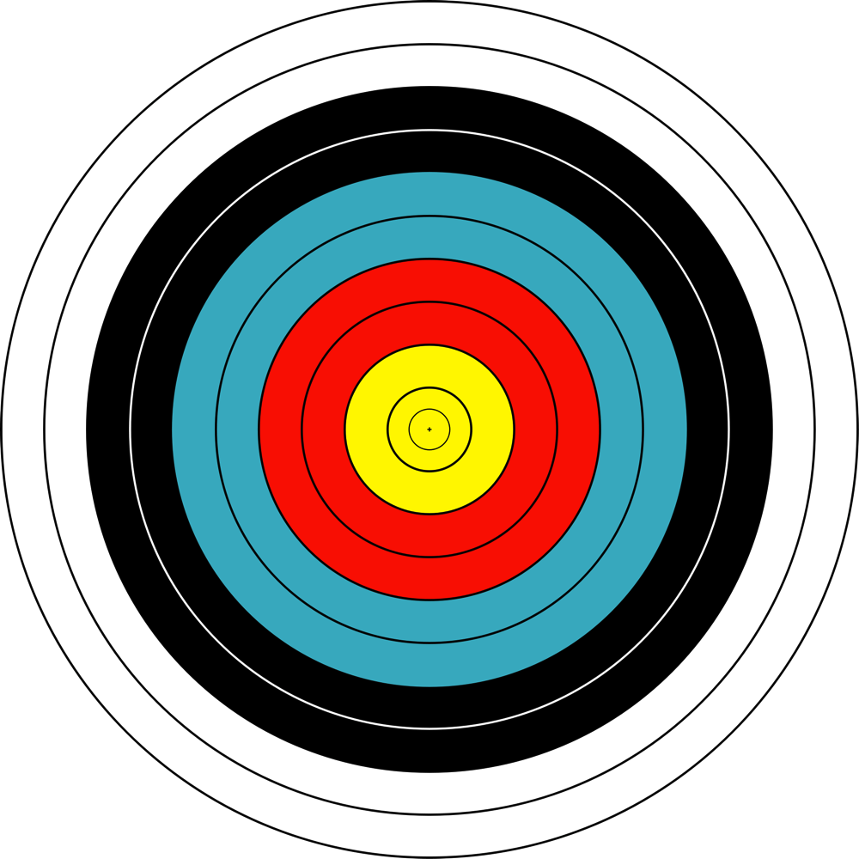
...it is better to be vaguely right than precisely wrong!

Slide 38
The following presentations will elaborate on these issues, present alternative views and discuss what it means for management

Slide 39
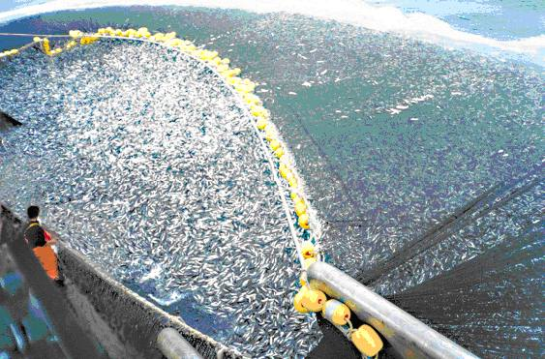
Enjoy !

Slide 40
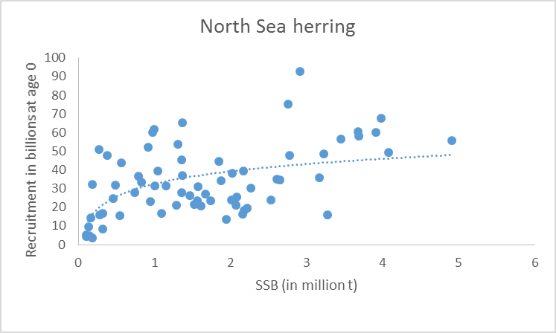
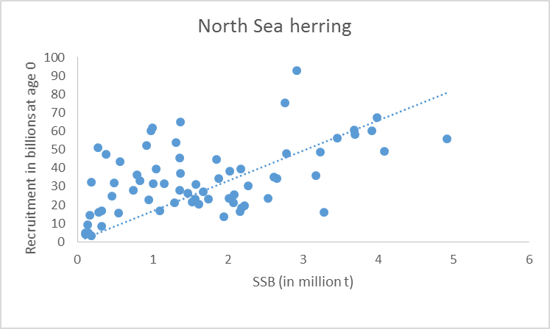

Why does DD gives higher Fmsy ?
– an illustration
If this was the truth out in the sea – then stop fishing – the stock will build up – recruitment will be larger and larger – build up the stock more and so on
---Fmsy will be very small, actually you should wait 1000 years and you could walk on herring from Denmark to England
Of course this is not a good model – you need DD
Notes:
Remember this is an animation

Slide 41
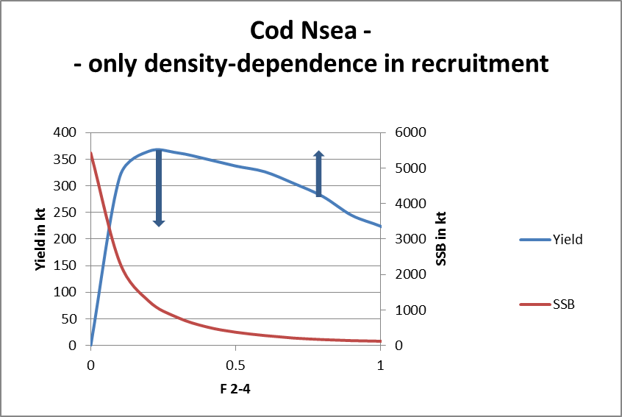
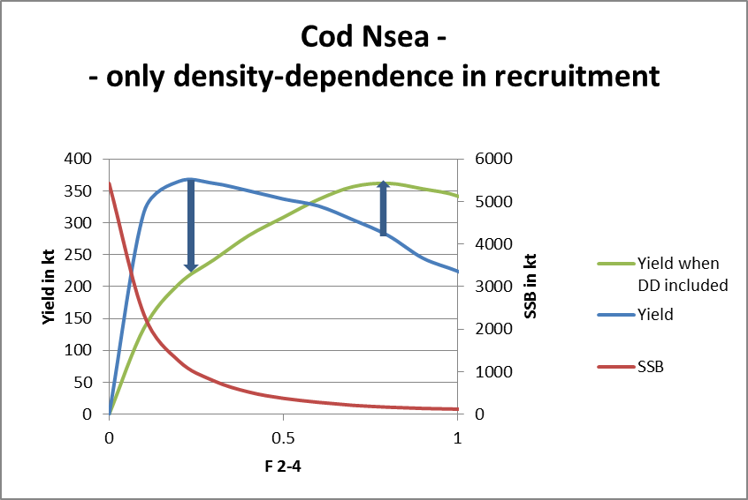
A more technical explanation...
Yield is No of individuals caught times their weight
If we include the right weight for a given SSB the calculated yield at a high SSB will go down and the yield for a low SSB will go up
...this will give the green curve – and a higher Fmsy

