Slide 1
Density dependence in fish populations
by Jan Horbowy*, Jeremy Collie**, Adrien Tableau**
*National Marine Fisheries Research Institute, Gdynia, Poland **University of Rhode Island, Narragansett, RI USA
Final Symposium: Optimizing sustainable fishing yields - ecosystem and management perspectives Copenhagen, 10-11 October, 2018

Slide 2
Introduction
ICES basis of the fisheries advice:
Maximum Sustainable Yield (MSY)
a) within a precautionary approach (PA)
b) integrating ecosystem-based management
Standard ICES approach to derive F_{MSY}:
Long-term stochastic simulations with age-structured model (S-R relationship, advice rule, precautionary approach included)
Constant: growth rate, maturity, natural mortality, fishing pattern
However, growth rate may change with change of stock size

Slide 3
Baltic sprat – an example of density-dependent growth (DDG)

Slide 4
Sprat: influence of density-dependent growth on MSY */ (black=constant growth, red=DDG)
Results of long-term stochastic simulations with constant & DD growth
MSY & Fmsy much higher when DDG included
DDG would also effect estimates of PA ref. points
Thus, checking evidence for DDG (and including DDG in simulations) is important for estimation of MSY parameters
*/ Horbowy, J., Luzenczyk, A. 2017. Effects of multispecies and density dependent factors on MSY reference points: Example of the Baltic Sea sprat. Can. J. Fish. Aquat. Sci. 74: 864–870. dx.doi.org/10.1139/cjfas-2016-0220

Slide 5
Stocks considered & Data
53 stocks were analyzed:
- 43 stocks from European waters (mainly cod, haddock, saithe, whiting, herring, sole, plaice)
-10 US stocks from northwest Atlantic (cod, haddock, flatfishes from Gulf of Maine & Georges Bank)
Data
Weight at age data: from ICES WGs; where possible taken as WEST (weight in the stock) , otherwise WECA (weight in the catch)
Biomass (TSB, SSB) and recruitment: most recent ICES assessment (2017 or 2018)
USA data: Northeast Regional Stock Assessment Workshop

Slide 6
Methods: some details of growth model
Andersen & Ursin (1977) differential form of von Bertalanffy growth equation
$$\frac{dw}{dt}=vhfw^{2/3}−kw$$
w = weight f = feeding level h = anabolism coefficient k = catabolism coefficient v = fraction of assimilated food used for growth
Q = parameter
$W_{inf}={(\frac{vhf}{k})}^{3}$,
$f=\frac{food}{food+Q∗Stock}$
From Ford-Walford equation (K=k/3, Incr = increment)
${Incr=w}_{t+1}^{1/3}−e^{−K}w_{t}^{1/3}$=${W_{inf}}^{1/3}(1−e^{−K})$=$\frac{vhf}{k}(1−e^{−K})$
The term ${Incr=w}_{t+1}^{1/3}−e^{−K}w_{t}^{1/3}$ may be called “normalised” increment as it does not depend on age. However, it depends on stocks size (through f). Taking reciprocals leads to
$$({Incr)}^{−1}=α+β∗Stock$$
(reciprocal of „normalised” increments as linear function of stock size)
where 𝛼, $β$ are parameters.

Slide 7
Methodological problems
In simple statistical analysis of the type
weight = function of biomass
spurious correlations (positive) may occur as weight is present at both side of the above equation.
Spurious correlations were illustrated in simulations by:
- generating random weights and random stock numbers (through random recruitment)
- relating different measures of growth change to stock biomass.
Conclusion: Modeling weight increment gives relatively low number of spurious positive correlations between growth & biomass.

Slide 8
Density-Dependent Growth: options considered
Four options of possible density dependence in growth (DDG) in relation to biomass & recruitment were considered :
average (over ages) yearly increment in weight as dependent on:
TSB (total stock biomass), yIncr vs TSB
SSB (spawning stock biomass), yIncr vs SSB
average yearly increment in weight over entire cohort as dependent on recruitment abundance, ycIncr vs R
average relative weight over entire cohort as dependent on TSB (similar to Cook et al. 1999, J. Northw. Atl. Fish. Sci., Vol. 25: 91–99), ycRelW vs TSB

Slide 9
Results
Negative DDG - summary over the models as % of occurrence (at 5% level)
Summary over groups of species:
clupeidae 55 %
gadidae 33 %
flatfishes 25 %
Stock dynamics measured as range or CV of biomass (recruitment) did not have clear effect on DDG

Slide 10
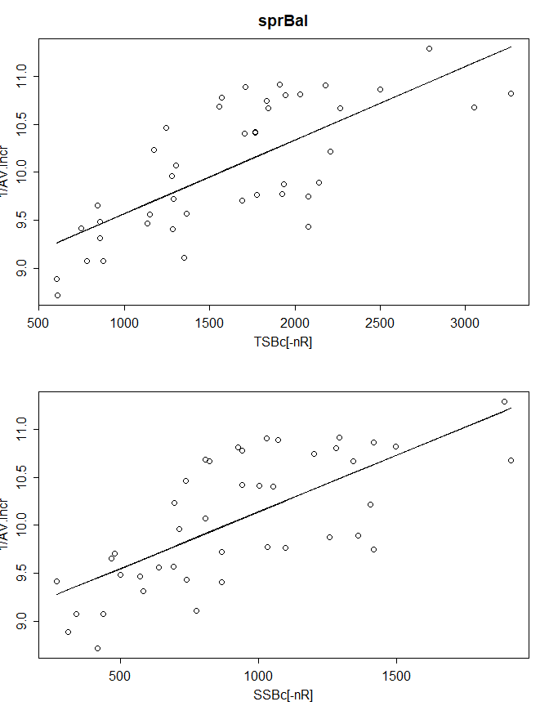
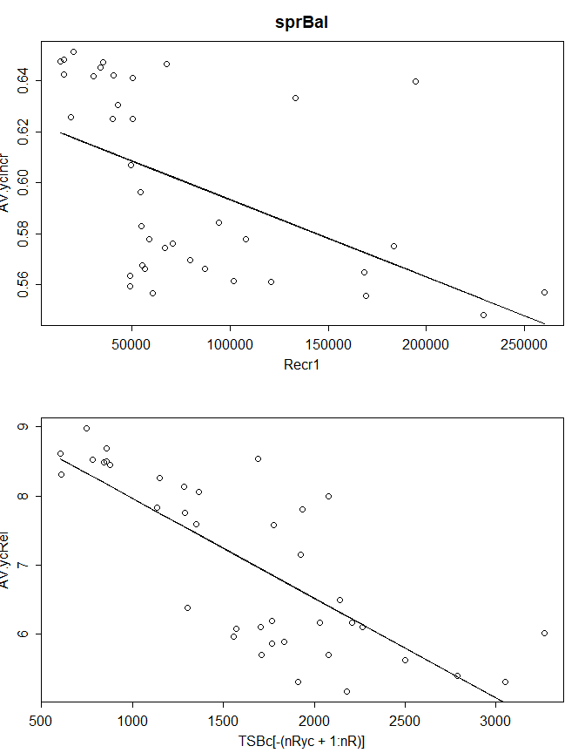
Results
Example of strong negative DDG – Baltic sprat
Reciprocal of yearly increments vs biomass, R² ca. 0.5
Year class increments vs Recr. & biomass, R² ca. 0.3-0.5

Slide 11
Conclusions
Density Dependent Growth (DDG) may have substantial impact on estimates of MSY parameters (Baltic sprat example).
DDG occurs for quite high percentage of stocks:
over 30% for given model,
almost 50% for at least one of the models.
however, in some cases relationship was rather weak
It is recommended to consider DDG in estimates of MSY parameters

Slide 12
Thank you
☺

Slide 13
Red = significant yearly increments
Green = significant changes over cohort

