Slide 1
Multispecies and ecosystem knowledge
Daniel Howell
IMR, Norway

Slide 2
Multispecies and ecosystem knowledge
From the modelling side
And from the ecosytem side
Start with the models, but first..

Slide 3
Density dependent?
There are density dependent processes in nature
Where there are physical space limitations
These are not what we are talking about today
We can model food limitations as «density dependence»
Providing food supply remains constant
DD is a simplification
In practice food limitation (on ELS, on growth, on maturation) and cannibalism will vary more than this
the assumptions need examining for each case

Slide 4
Fmsy in a multispecies world
It makes no real sense to talk about «the maximum sustainable yield of a fish» without also talking about
what it eats,
what it competes for food with,
and what eats it
And yet we do it all the time

Slide 5
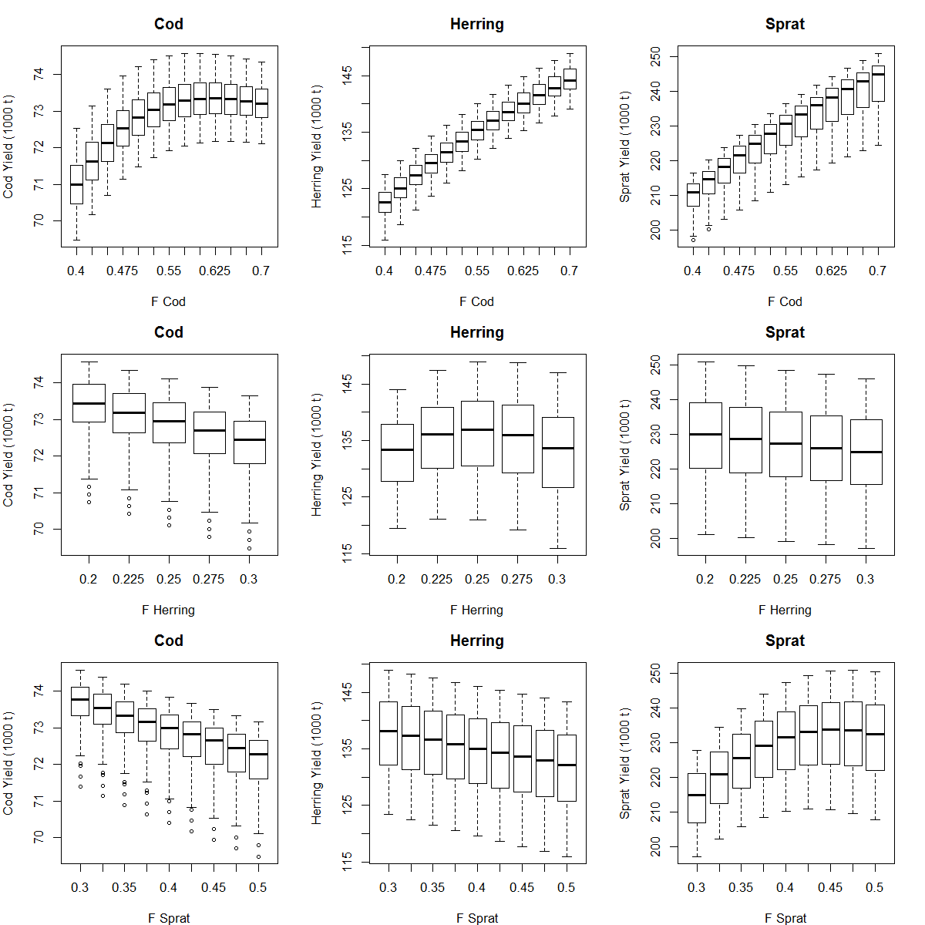
Trade-offs: Baltic Style

Slide 6
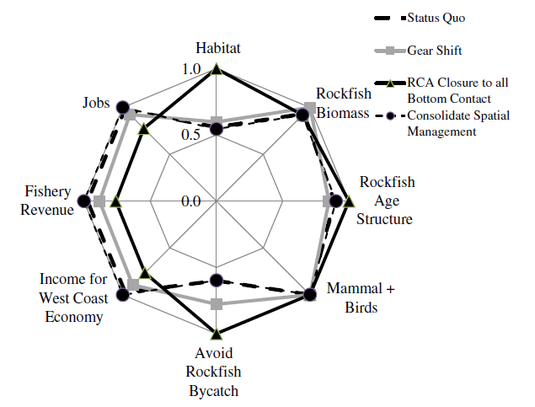
Trade-offs: US style

Slide 7
Towards ecosystem management
Requires choices to be made
Produces winners and loosers
We have got good at harvesting as much as we can (and more!)
Unlikely to be more fish for all
May involve increased fishing pressure on some stocks
Moves away from the «if in doubt fish less» precautionary world
=> Places a very high demand on the accuracy of the models
Of the complex, difficult and uncertain models

Slide 8
Single species models
Don’t underestimate these
Data tuned, can give successful management
Long history
Can see when we fished too hard or too lightly
Choice of age range can sidestep much of the ecosystem interactions
Can import variable predation mortalities from stomach data or multispecies modelling
Completely and utterly miss all ecosystem interactions and feedbacks

Slide 9
Production/surplus production models
Only model biomass pool, no process modelled
Data tuned, limited data requirements
Requires good catch data, assumes stock size driven by catch (not by varying environment, recruitment,…), B_{t+1}~B_{t}

Slide 10
MICE/Extended single species models
Complex enough to model interactions, simple enough to be data tuned
E.g. SMS, Gadget, LeMans, Hydra…
Potentially data tuned, good at modelling predation-induced mortality
Complex, high data requirements, difficult to validate, not very transparent, poor at modelling bottom up processes (food limitation)

Slide 11
Whole Ecosystem / End2End models
E.g. Ecopath, Atlantis
Wide perspective
Good at modelling bottom-up processes
Can nest fish submodels within a whole ecosystem
Complex (potentially very complex), difficult to construct, not always transparent
Not data tuned

Slide 12
Summary of multispecies modelling tools
Multiple different methods to
calculate Fmsy, all flawed

Slide 13
Summary of multispecies modelling tools
Multiple different methods to
calculate Fmsy, all flawed

Slide 14
Summary of multispecies modelling tools
Multiple different methods to
calculate Fmsy, all flawed

Slide 15
Compare output from different models
Cannot know the truth
Ever
But if different approaches give similar answers our confidence in those answers increases
And even if they don’t, it tells us something

Slide 16
Comparing apples and oranges
Using Fmsy as a tool for comparison is problematic
F0.1 vs. Fmax
YPR vs. SPR
Precautionary vs. «pure» Fmsy
Fbar vs. F fully selected vs. F over fishable population
Same F, different selectivity, gives different catches
Variable recruitment/environment vs. Fixed Fmsy
Non-unique solutions

Slide 17
Different Fmsy estimates: N. Sea

Slide 18
Different Fmsy estimates: N. Sea

Slide 19
Different Fmsy estimates: N. Sea
Regime Shift?

Slide 20
N. S cod and haddock
Possible answers
Regime shift?
Currently at low stock size?

Slide 21
Different Fmsy estimates: N. Sea

Slide 22
Different Fmsy estimates: N. Sea

Slide 23
Different Fmsy estimates: N. Sea

Slide 24
Hake
North Sea hake is not really «a stock»
It’s the northern end of the much wider hake stock in western Europe
Stock size is driven by fluctuations in this larger stock
Not by catches in the North Sea
Violates key assumption of production model

Slide 25
Different Fmsy estimates: N. Sea
Regime Shift?

Slide 26
Different Fmsy estimates: Barents Sea

Slide 27
Notes
No clear pattern between ecosystem based approaches
Often «multispecies Fmsy» values are higher
«density dependence»
But not always
Need to be very careful about assumptions of stationarity
A route to question our assumptions

Slide 28
So…
We have multiple models
None of them perfect
But together they do let us go beyond single species evaluations
And we really do want to go beyond them
The single species models make assumptions we know are wrong
Single species doesn’t avoid density dependence, it just assumes it’s zero

Slide 29
Ecosystem insight on density dependent Fmsy
Density dependent Fmsy is…
is…
wait for it…
density dependent

Slide 30
Errr, what….?
N. Sea cod SSB Barents Sea cod SSB

Slide 31
Density dependence
Density dependence will matter most at high stock sizes
And much less at low stock sizes
Would potentially senisble to use DD F_{target} values for high stock sizes
Would not be sensible to use DD F_{target} values at low stock sizes

Slide 32
North East Arctic Cod HCR

Slide 33
Variable F
HCR simulations in the Flemish Cap
Work with Alfonso Perez Rodriguez
Trying to keep redfish and cod stocks and catches helathy under variable recruitment
Much easier to find HCRs that meet these goals if you have two step HCRs

Slide 34
Harvest Control Rule evaluations
We need more than just «good average» yield
We also need precautionary management
Recruitment is variable, assessments are uncertain, target Fs are poorly implimented
A F_{target} value that looks good with no noise or variability may not be so good in the real world
Management Strategy Evaluations/Harvest Control Rule evaluations
Check that the fishing rule is precautionary to this variability
Allow for comparing between HCRs

Slide 35
Stability
We need to be careful about assumptions of stability
Calculating F from one set of environmental conditions and applying it to another would be a bad idea

Slide 36
Stability
N. Sea cod SSB Barents Sea cod SSB
Regime shift?
Reduced
sea ice

Slide 37
Final Thoughts
Moving into ecosystem/multispecies management places ever greater demands on our modelling
Need to move carefully, and with (magic word alert) precaution
But really do need to move
The ecosystem is still there even if we try and ignore it
Borrowing strength between approaches is an obvious way to attempt to square this circle

Slide 38
Final Thoughts
Which model should we use for Ftarget?
Wrong question
We should use the range of available models
Should we use density dependent Fmsy for all ICES stocks?
Wrong question
«one size» never fits all
Should we consider using density dependent Fmsy for some ICES stocks?
Very good question, I’m glad you asked…
Consider on a stock-by-stock basis, for some stocks it may be a good idea
NEA cod is one where we do exactly this

Slide 39
Final Thoughts
Density dependent Fmsy check list:
Can we statistically detect DD in the stock?
Is it a large enough effect to matter?
Is the stock currently at high stock size?
Have we evaluated the proposed HCR to be precautionary?
Do we understand the process?
Managing based on regression alone is dangerous

Slide 40
Engage brain…
Never trust the model
Or the modeller!

Slide 41
Engage brain…
Never fully trust the model
Or the modeller!
Use common sense when changing management
Don’t rapidly and drastically increase F just because a model says so
Especially if this outside the range of recent tuning data
Bring the change in gradually and monitor it
If a F or catch level is near those that previously crashed the stock:
be very careful before doing that again
Make sure the changes make sense given the stock situation

Slide 42
Thank you

