Slide 1
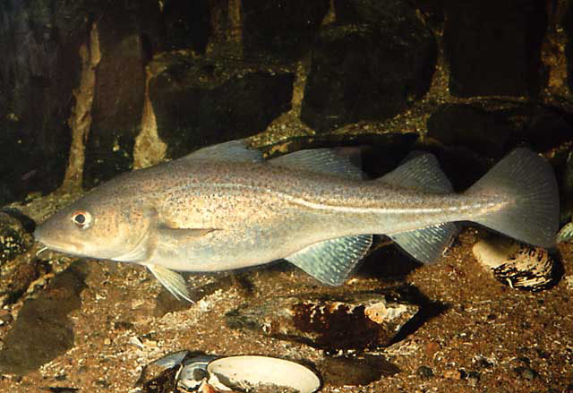
The cod in Barents Sea and Icelandic Waters - experience and ways forward
Symposium on optimizing sustainable fishing yields - ecosystem and management perspectives, Copenhagen 10-11 October 2018

Slide 2
Barents Sea (BS) and Icelandic cod (Gadus morhua)
Currently the two largest cod stocks in the world
Biology, ecology and physical environment of both stocks are quite similar, but some notable differences
Both stocks used to be overexploited
Following introduction of harvest control rules (ICE: 1996, BS: 2003) fishing pressure has been reduced and cod stocks and catches have increased in both areas
Some challenges have been encountered along the way and some lessons learned
Time to sum up experiences and look ahead

Slide 3
Biology of the two cod stocks
Both are long-lived, slow growing and late maturers (age 6-7 at first spawning) compared to cod found in warmer waters
Icelandic cod grow and mature slightly faster than BS cod (about half a year difference at age 6-7)
The most important commercial fish species and also the main predatory fish in both areas
Both have capelin as their main prey

Slide 4
Management of the two cod stocks
Managed by one or two countries (Norway/Russia in Barents Sea, Iceland in Icelandic waters)
Annual assessments and advice by ICES, quotas (TACs) set annually
Fished both by trawl and conventional gears
Minimum size and closed areas:
Barents Sea: 44 cm, max 15% undersized fish by numbers allowed
Icelandic waters: 55 cm, max 25 % undersized fish by numbers allowed
Both areas: Some mixed fisheries, in particular with haddock

Slide 5
Iceland – cod distribution area - March
Notes:
Mainly limited by 500m depth contour

Slide 6
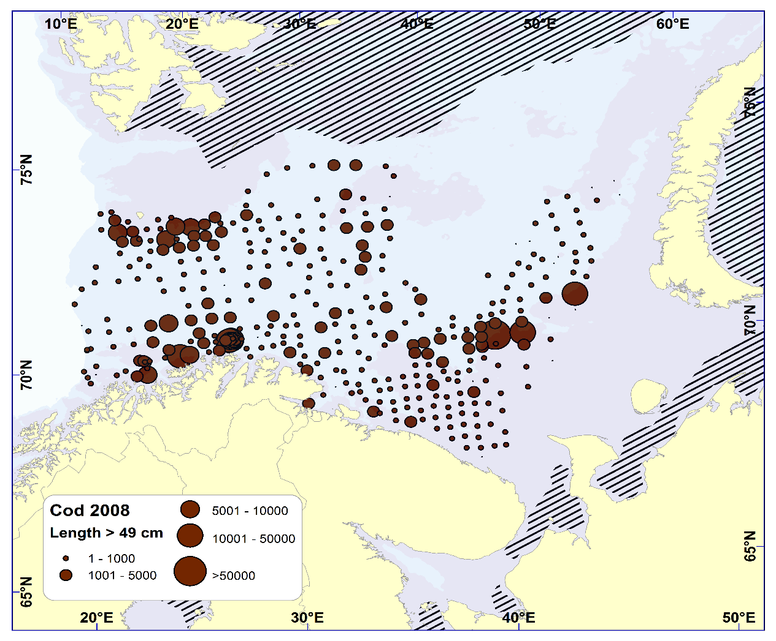
Barents Sea cod >= 50cm distribution – winter 2008 and 2018

Slide 7
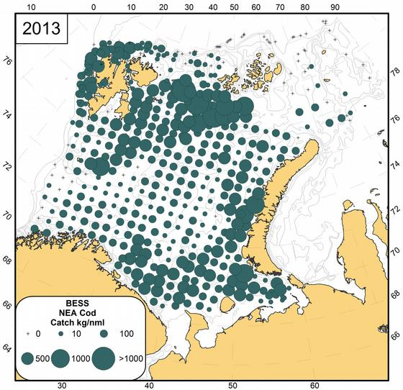
Barents Sea cod distribution autumn 2004 and 2013

Slide 8
Stock history

Slide 9
Recruitment

Slide 10
Stock-recruitment
Notes:
Longer time series and thus some of the highest BS values not on previous plot. More variable recruitment in BS

Slide 11
Fishing and exploitation history

Slide 12
Mean weight in catch (kg round weight)

Slide 13
Icelandic harvest control rule – from 2009->
The HCR upon which the TAC is set when the SSB in the assessment year is estimated to be above $SSB_{trigger}$ (220 kt) is as follows:
$TAC_{y/y+1}=(0.20∗B_{4+,y}+TAC_{y−1/y})/2$
In case the SSB is estimated to be below $SSB_{trigger}=220kt$ the 0.20 multiplier is reduced linearly.
The $B_{4+,y}$ refers to the reference biomass (4 years and older) in the beginning of the assessment year ($y$). The notation $y/y+1$ refers to the next fishing year (starting 1. September of the assessment year) and $y−1/y$ to the current fishing year (ending 31. August of the assessment year).

Slide 14
Barents Sea harvest control rule from 2016->
The TAC is calculated as the average catch predicted for the coming 3 years using the target level of exploitation (F_{tr}).
The target level of exploitation is calculated according to the spawning-stock biomass (SSB) in the first year of the forecast as follows:
- if SSB < B_{pa}, then F_{tr} = SSB / B_{pa} × F_{msy};
- if B_{pa} ≤ SSB ≤ 2×B_{pa}, then F_{tr} = F_{msy};
- if 2×B_{pa} < SSB < 3×B_{pa}, then F_{tr} = F_{msy} × (1 + 0.5 × (SSB - 2×B_{pa}) / B_{pa});
- if SSB ≥ 3×B_{pa}, then F_{tr} = 1.5 × F_{msy};
where F_{msy}=0.40 and B_{pa}=460 000 tonnes.
If the spawning–stock biomass in the present year, the previous year, and each of the three years of prediction is above B_{pa}, the TAC should not be changed by more than +/- 20% compared with the previous year’s TAC. In this case, F_{tr} should however not be below 0.30.
In 2014, JNRFC decided that from 2015 onwards, Norway and Russia can transfer to or borrow from the following year up to 10% of the country's quota.

Slide 15
Harvest control rule comparison (simplified)

Slide 16
Harvest control rule development
Iceland:
Started in 1995/96
Multiplier reduced from 0.25 to 0.20 over time
Barents Sea:
Started in 2003
Lower limit of F (0.30) introduced in 2009
Increased F at high SSB added in 2016, also limit on annual change of TAC increased from 10 to 20%

Slide 17
Testing of harvest control rules
Develop operating model
Within which range of stock size and exploitation can this model be considered realistic?
Long-term stochastic simulations where stock/recruitment has a stchastic element and assessment error is taken into account (minimum complexity)
Possibly also account for density-dependent effects, implementation error, biases etc.
Tabulate yield, risk (e.g. SSB< Blim) and variability in catches

Slide 18
Challenges with implementation
TAC set above advice
Catches above TAC
Errors in stock assessment
In the first years with a HCR for Icelandic cod, stock size was overestimated and catches were also somewhat above agreed TAC. Works well now
For Barents Sea cod, IUU catches were high in first years after introduction of HCR. Then after such catches were eliminated, stock size was underestimated for some years and thus fishing mortality became lower than originally intended. Works better now but difficult to make managers follow advised reductions in TAC

Slide 19
Fishing mortality related to HCR

Slide 20
Density-dependent factors
Recruitment
Growth
Cannibalism
Density-dependent factors are more important in Barents Sea and density-dependent growth and cannibalism acocunted for in evaluation of HCRs there
Density-dependence in growth also accounted for in first simulations for Icelandic cod

Slide 21
Barents Sea cod yield vs F – changing selection pattern and density-dependence (Kovalev and Bogstad 2005)
Notes:
Remember Fmax around 0.25

Slide 22
Going into the unknown when reducing F considerably?
In previous periods with high stock size there may not have been surveys and other data may also be scarce – particularly a problem for older fish
Also physical environment and ecology may have changed since then
Expanding stocks – expansion of survey area lagging, also observations of large amounts of older fish which are outliers in time series may cause assessment problems – experience from Barents Sea
Large catches and large fish in catches also may cause some ’luxury problems’ for the fishery and industry (too large fish, too large individual catches, lower prices… )

Slide 23
Some final points
HCR implementation took some time for both cod stocks but must be considered as fairly successful now
Need some adjustments of models and HCRs along the way
A HCR is not better than its biological basis and implementation
Take care to extrapolate model results outside range of observations. In previous periods with high stock size there were quite likely no surveys and other data may also be scarce
Dialogue with managers and industry very important but not going into that here
Notes:
Density dep on lder cod only

Slide 24
Acknowledgements
FMSY project
ICES AFWG and NWWG
Guðmundur Þordarson and Höskuldur Björnsson, MRI, Iceland

