Slide 1
Results from SPiCT
Rob van Gemert
rvge@aqua.dtu.dk
10 October, 2018

Slide 2
What is SPiCT?
Stochastic surplus production model in continuous time

Slide 3
Why SPiCT?
Density dependence
Recruitment
Growth
Maturity
Cannibalism
Uncertainty

Slide 4
Stocks
Northeast Atlantic mackerel
North Sea herring
North Sea plaice
North Sea cod
Blue whiting
Misreporting & variability

Slide 5
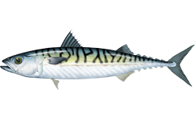
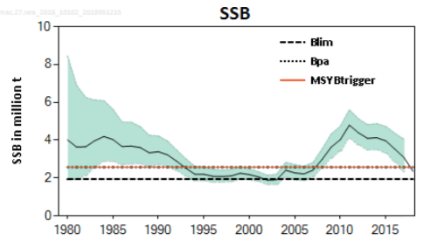
NEA Mackerel
ICES, 2018

Slide 6
NEA Mackerel Misreporting
1980s: Klondyking
1990s: Highgrading
Early 2000s: Illegal, unregulated, unreported catches

Slide 7
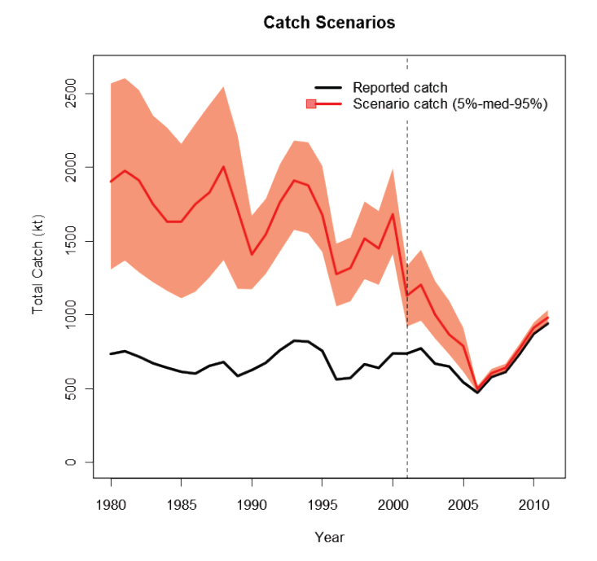
NEA Mackerel Misreporting
Miller & Sparrevohn, 2013

Slide 8
NEA Mackerel
ICES F_{MSY}: 0.21 yr⁻¹
Without correction for misreporting: F_{MSY} = 0.32 yr⁻¹ (0.12-0.82)
With correction for misreporting: F_{MSY} = 0.24 yr⁻¹ (0.18-0.35)
Notes:
Biomass index: SSB

Slide 9
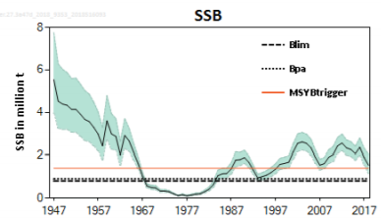
North Sea herring
ICES, 2018

Slide 10
North Sea herring
ICES F_{MSY}: 0.33 yr⁻¹
SPiCT F_{MSY}: 0.46 yr⁻¹ (0.32-0.67)
Notes:
SSB as biomass index

Slide 11
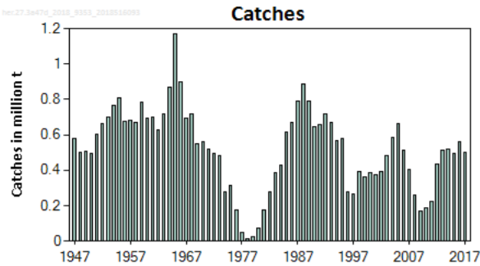
North Sea herring Misreporting
1977-1982
Closure of the North Sea herring fishery
ICES, 2018

Slide 12
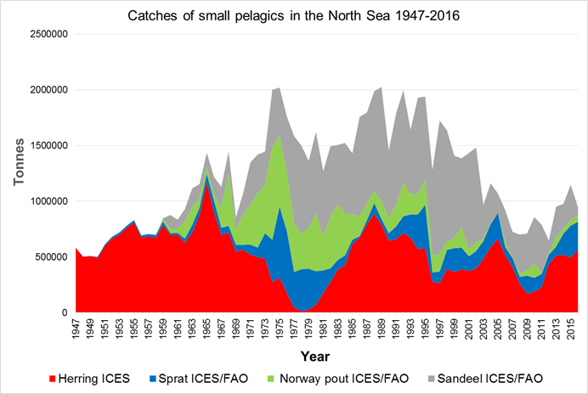
North Sea herring Misreporting

Slide 13
North Sea herring Misreporting
ICES F_{MSY}: 0.33 yr⁻¹
Excluding misreported years (´77-´82): F_{MSY} = 0.38 yr⁻¹ (0.26-0.56)
Corrected using IBTS indices and 1982-1984 catch data: F_{MSY} = 0.39 yr⁻¹ (0.28-0.54)
Notes:
Biomass index: SSB

Slide 14
North Sea herring
ICES F_{MSY}: 0.33 yr⁻¹
SPiCT F_{MSY}: 0.46 yr⁻¹ (0.32-0.67)
SPiCT F_{MSY} (year removal): 0.38 yr⁻¹ (0.26-0.56)
SPiCT F_{MSY} (catch correction): 0.39 yr⁻¹ (0.28-0.54)
Constant productivity?

Slide 15
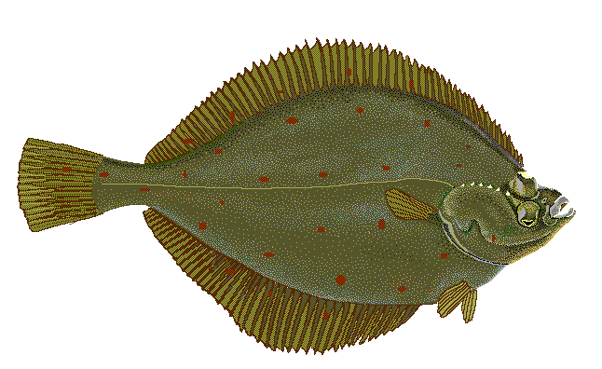
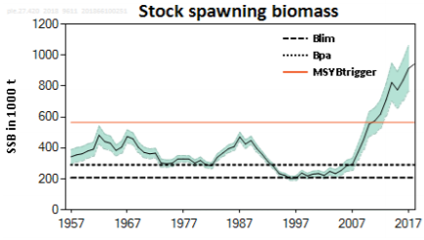
North Sea plaice
ICES, 2018

Slide 16
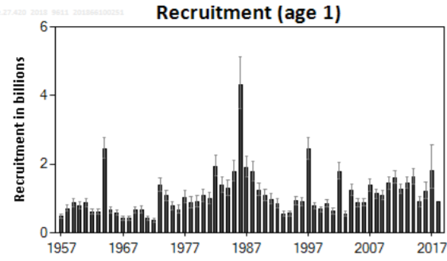
North Sea plaice Abnormal recruitment
ICES, 2018

Slide 17
North Sea plaice
ICES F_{MSY}: 0.33 yr⁻¹
SPiCT F_{MSY}: 0.44 yr⁻¹ (0.17-1.20)
SPiCT F_{MSY} (year removal): 0.55 yr⁻¹ (0.21-1.48)
Notes:
Biomass index: effort (F) for top fit, and Catch/F for year removal fit

Slide 18
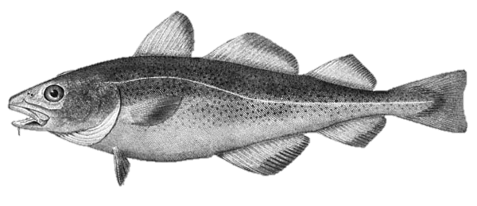
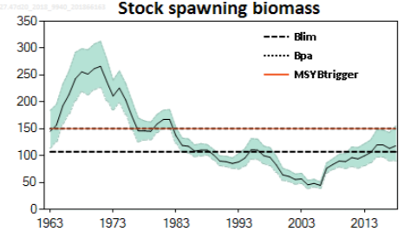
North Sea cod
ICES, 2018

Slide 19
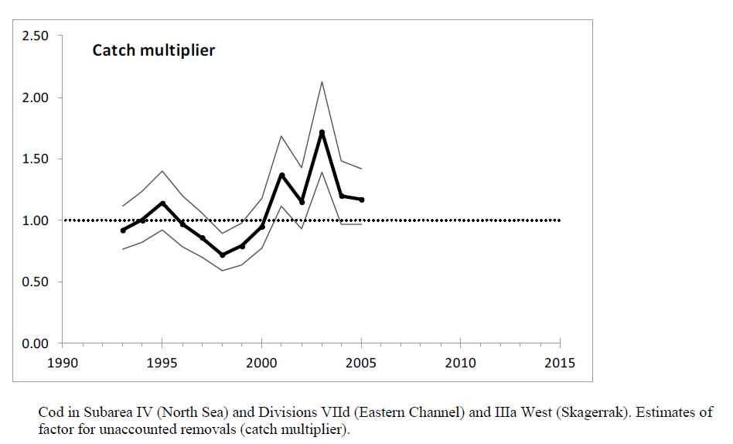
North Sea cod Misreporting
ICES, 2013

Slide 20
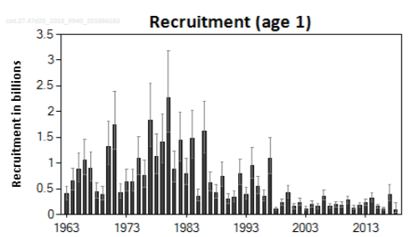
North Sea cod Gadoid outburst
ICES, 2018

Slide 21
North Sea cod
ICES F_{MSY}: 0.31 yr⁻¹
SPiCT F_{MSY}: 0.63 yr⁻¹ (0.31-1.36)
SPiCT F_{MSY} (catch correction, ACOM 2012): 0.69 yr⁻¹ (0.43-1.10)
Notes:
Biomass index: effort (F)

Slide 22
North Sea cod
ICES F_{MSY}: 0.31 yr⁻¹
SPiCT F_{MSY} (regime shift): 0.50 yr⁻¹ (0.20-1.23)
SPiCT F_{MSY} (regime shift & catch correction): 0.48 yr⁻¹ (0.16-1.42)
Notes:
Biomass index: effort (F)

Slide 23
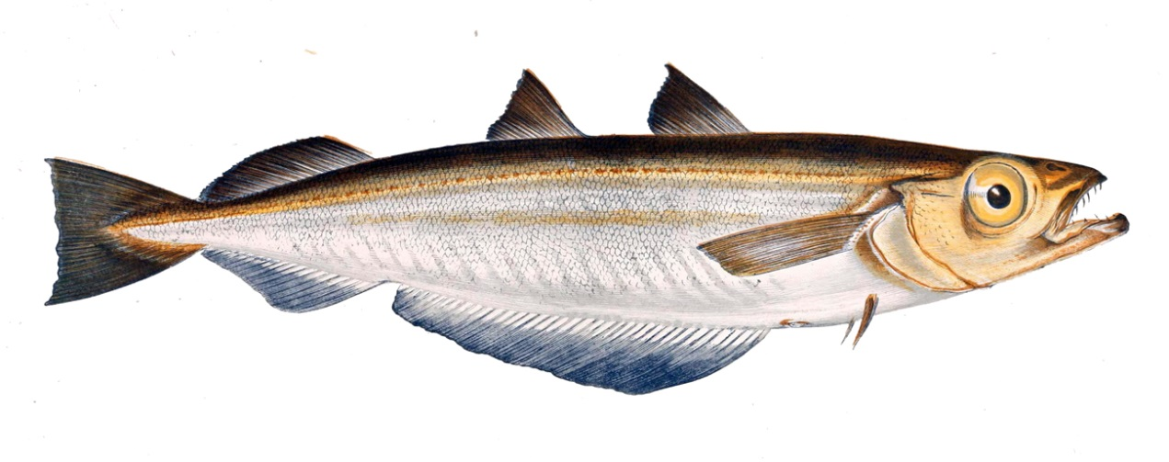
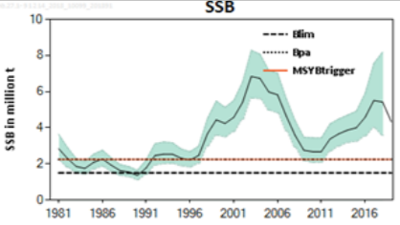
Blue whiting
ICES, 2018

Slide 24
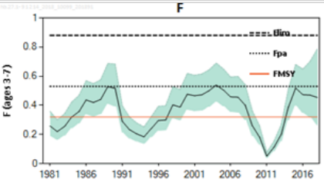
Blue whiting Catch abnormality
2011: catch advice set too low

Slide 25
Blue whiting
ICES F_{MSY}: 0.32 yr⁻¹
SPiCT F_{MSY}: 0.50 yr⁻¹ (0.16-1.64)
SPiCT F_{MSY} (year removal): 0.40 yr⁻¹ (0.13-1.22)
Notes:
Biomass index: catch/F

Slide 26
Conclusions
SPiCT consistently estimates higher F_{MSY} than ICES advice
Often a high level of uncertainty
 | ICES advice Fmsy | ICES Fmsy unprecautionary | SPiCT Fmsy, plus 95% C.I.
North Sea cod | 0.31 | 0.31 | 0.50ª (0.20-1.23)
North Sea plaice | 0.21 | 0.21 | 0.55 (0.21-1.48)
North Sea herring | 0.33 | 0.33 | 0.38 (0.26-0.56)
Atlantic mackerel | 0.21 | 0.23 | 0.32ª (0.12-0.82)
Blue whiting | 0.32 | 0.419 | 0.40 (0.13-1.22)
ª Not corrected for misreporting.

