Slide 1
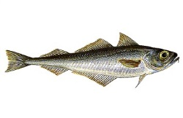
Linking Fmsy to life-history parameters and ecosystem state
By John G. Pope; Erla Sturludóttir; Henrik Gislason; Michael Melnychuk; Henrik Sparholt; Gunnar Stefansson

Slide 2
The Problem
Multispecies Models suggest that Single Species Fmsy’s often are low.
For Example - Pope et al. 2018 fitted 4 multispecies models to North Sea, 3 to Baltic and 2 to Icelandic fish stocks.
Over all these models -Increasing fishing mortality on a species would increase its yield in 78% of cases.
However, they also find inter-model variation in predicted yield.
So SS models are Biased but MS models are Variable.
Life history parameters have a long history in MSY studies.
Could linking life history parameters to the ecosystem state help?

Slide 3
Some Clues: Coexistence and the scaling of recruitment (Pope et al.(2006) and Hall et al.(2006) )
Size-based multispecies models of the North Sea and Georges Bank found for Coexistence, recruitment had to scale with L∞ to powers of -3.5 or -2.5, or only the largest species would persist (Pope et al.2006, Hall et al.2006).
While Denney et al. 2002’s data analysis found Max. no. of recruits per kg spawner at low levels of spawning stock biomass scaled as L∞ to the power of -3.0
Notes:
The same scaling was found by Denney et al(2002) when they compared estimates of the maximum no of recrutis produced per unit of spawning stock biomass for fish of different maximum length

Slide 4
The Empirical Evidence
Max. no. of recruits per kg spawner at low levels of spawning stock biomass
Based on data for 55 northeast Atlantic fish stocks (Denney et al. 2002)
10000
1000
Max. Rec. = 10⁶ L_{max}^{-3.0}
100
R
2
= 0.59
Max. no. of
10
spawner
recruts per kg
1
Demersal
0,1
Pelagic
0,01
10
100
1000
Maximum length, L_{max} (cm)
In seasonal seas this scaling seems unlikely to be due to differences in fecundity!

Slide 5
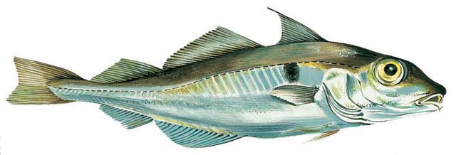
Why- If fecundity was the answer haddock would have to produce 8 and Norway pout 200 times more eggs per kg than cod.

Slide 6
Why- If fecundity were the answer haddock would have to produce 8 and Norway pout 200 times more eggs per kg than cod.
So how can a three order difference in the maximum number of recruits per kg spawner be explained?

Slide 7
Natural Mortality that increases with L∞ seems a plausible cause for recruitment scaling with L∞
The natural mortality after settling has been reported to scale with L∞ (Pauly 1980) as well as with individual length, L (McGurk 1986, Lorentzen 1996)
This suggests –
$$M=h{{(L}_{∞})}^{i}L^{n}$$
Where i is positive and n negative.
I.e. M gets smaller with Length for all species
But bigger species have higher M at same length
Gislason, Pope, Rice & Daan(2008)

Slide 8
This eventually lead to the Charnov, Gislason and Pope (2013) equation:
M=K*(L∞ /L)^{1.5}
This equation is justified:
- by regression of mortality data from low F stocks
from coexistence calculations with F=0
by the natural mortalities estimated by MSVPA

Slide 9
However, this equation is calculated for Fishing Mortality that was zero or low.
But multispecies models and size spectrum theory both suggest that
- M would scale with increasingly negative powers of L as fishing mortality increases
Put simply we would expect M to get smaller with size when the larger fish that cause it have been fished down.

Slide 10
This Suggests Changes to M=K*(L∞ /L)^{1.5}
More generally we could see the equation in 3 parts.
M= Prefactor(F)* (K* L∞ ^{1.5} )*L^{-Power(F)}
So both the Prefactor and the Power of L are functions of F and (K* L∞ ^{1.5} ) is a suitability term.
And the Power of Length gets more negative as F increases

Slide 11
Using the coexistence calculation of Gislason et al.(2008)
While keeping the same suitability term of K*(L∞)^1.5
At different levels of Fishing Mortality Rate we find.
Note the prefactor gets smaller and the power of L more negative as F gets bigger.

Slide 12
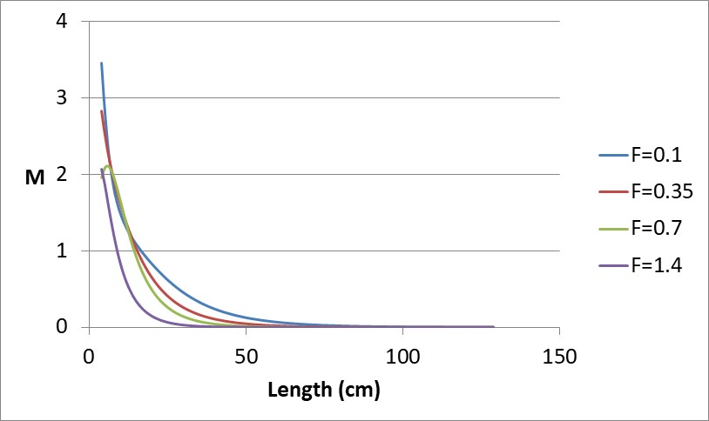
We can also make a version of the Pope et al 2006 model with suitability that follows this rule. Using this, M get lower as F get bigger.
Figure shows results for
L∞ =130cm.
Other L∞’s match this at lower levels

Slide 13
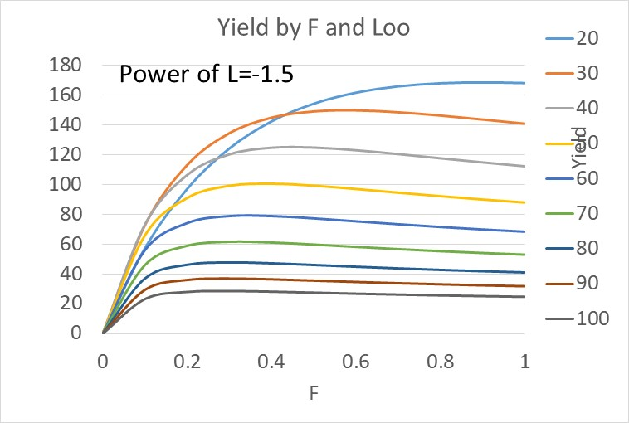
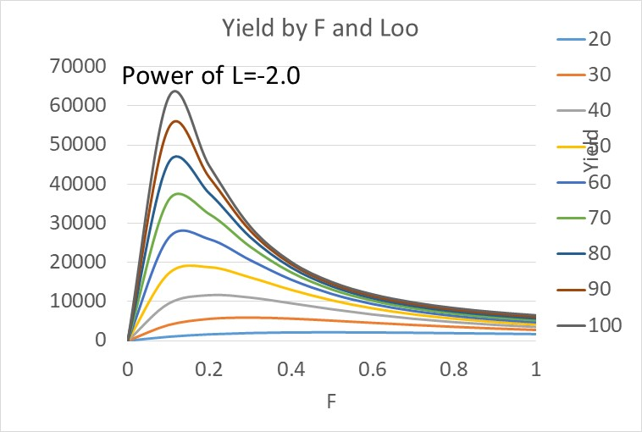
It is easy enough to calculate Yield per Recruit with such a formula for M for different powers of L.
But the question remains. How to link the Prefactor and Power of L to Fishing Mortality?

Slide 14
So How to go forward to Fmsy?
Size Spectrum theory suggests
M scales as L^(Constant+β) where β is the (negative) slope of the size spectrum of ln numbers on ln length.
Models show β gets more negative as F increases.
Moreover models suggests β change only slowly as F changes.
Thus the observed spectra from surveys could be used to estimate the current Prefactor and L power and these should persist for a while.
Such an approach to estimating M and hence Fmsy might be less biased than single species models and be less variable than Multispecies Models.
But how best to do this is a work in progress!

Slide 15
Thanks
That’s All Folks
"The Admiral" Guiseppe Arcimboldo

