Slide 1
An Introduction to SPiCT

Slide 2
Outline
What is SPiCT?
SPiCT tests and comparisons
Limitations and assumptions
Examples

Slide 3
Introduction
SPiCT: a Stochastic surplus Production model in Coninuous Time
Developed by Martin W. Pedersen and Casper W. Berg, now maintained by Casper W. Berg and Alexandros Kokkalis
Philosophy: Fast and stable model fitting with quantification of uncertainties
Asymmetric production curve
All input data and process equations contain noise, that is estimated in the model
Continuous time, does not rely on fixed annual data
Uncertainties on all output is reported, including MSY reference points
Notes:
Examples of use: 2017 ICES Working group on assessment of demersal stocks in the North Sea and Skagerak

Slide 4
Introduction
Reviewed and endorsed by ICES working groups (WKLIFE, WKPROXY, WKMSYCat34) and used for official advice.
Eastern Baltic cod reference points
Exploratory model for many stocks
Available in R
Published in Fish and Fisheries: Pedersen & Berg (2017)

Slide 5
Input data
Commercial catch time-series
Biomass index
Time-series length: at least 10 years of annual data, preferably more
Priors may also be used

Slide 6
Model assumptions/limitations
Closed population
Time-invariant production curve (however, this may be relaxed)
Size distribution on stock not modelled
Not all information about incoming year-class strength(s) is utilized
Size distribution in catches also not modelled
Changes in commercial selectivity cannot be incorporated
Contrast (both in small and large values) in time-series important to be able to estimate MSY reference points

Slide 7
Model output
Estimates of biomass and fishing mortality over time:
Relative to historical levels (high precision)
Relative to reference points (medium precision)
In absolute terms (low precision)
General philosophy: provide uncertainties on all reported quantities
Short-term forecast

Slide 8
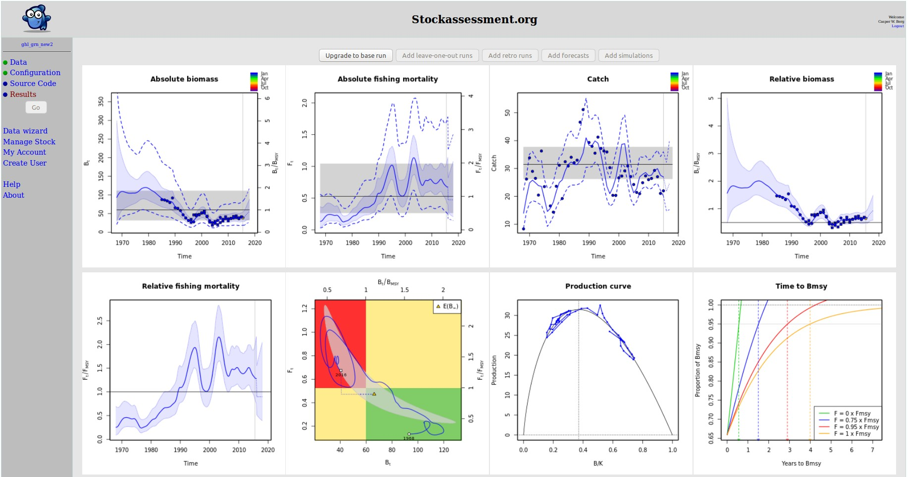
Model output
Screenshot from stockassessment.org

Slide 9
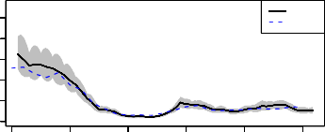
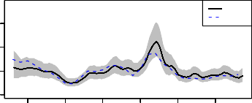
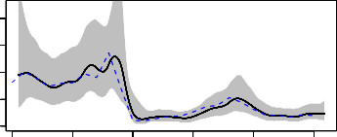
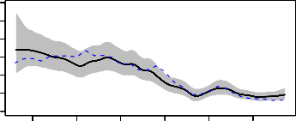
SAM comparison
Estimates of relative stock status are similar to those
of an age-based model (SAM)
4
20
5
SPiCT SAM
SPiCT SAM
4
1 2 3
Biomass
3
Biomass
2
1
0
0
1985
1990
1995
2000
2005
2010
1985 1990
1995 2000
2005 2010
3.0
4
3
2.0
F
2
F
1.0
1
0
0.0
1985
1990
1995
2000
2005
2010
1985 1990
1995 2000
2005 2010
Notes:
American plaice & North Sea haddock

Slide 10
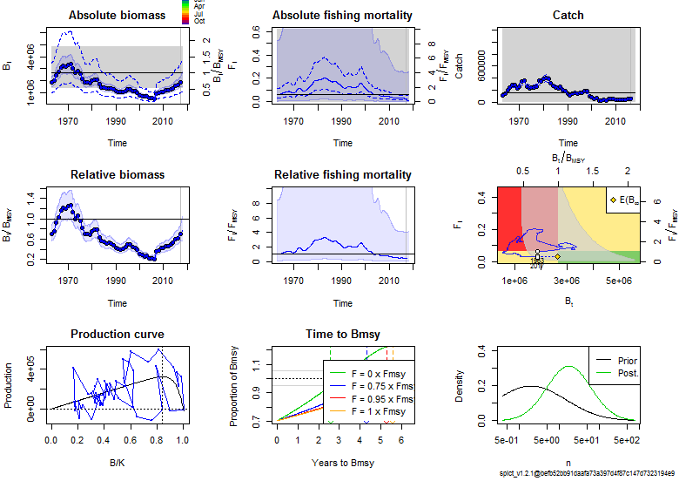
Failed fit

Slide 11
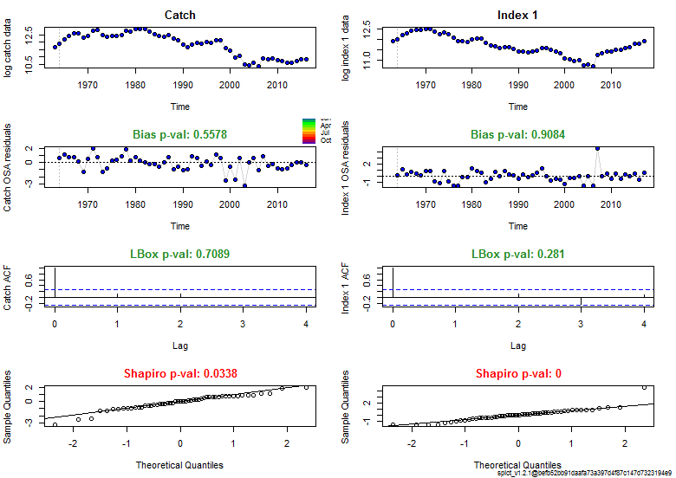
Diagnostic output
Still no guarantee for reliable fit

Slide 12
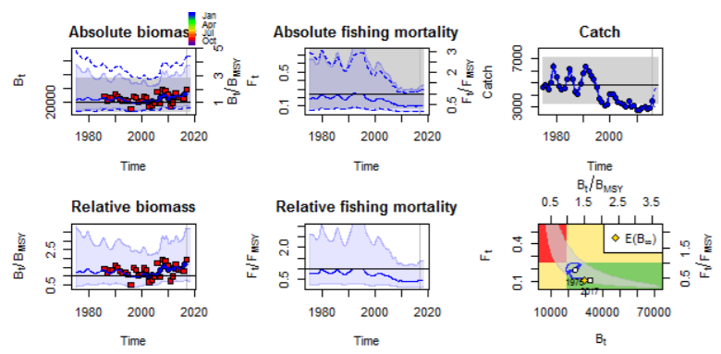
ICES Advice
North Sea turbot, 2017

Slide 13
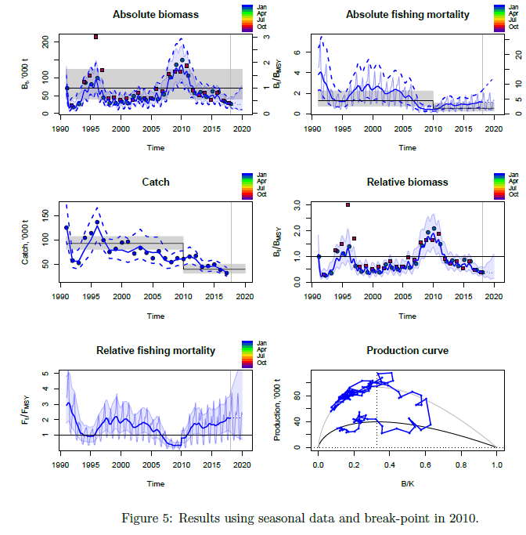
Change in productivity
Eastern Baltic Cod: SPiCT model with step-wise shift in MSY

Slide 14
To summarize
Stochastic surplus production model in continuous time
Especially useful for data-poor stocks
Incorporates and reports on uncertainty
Important to be aware of model assumptions
Interpret results with care

